Slide 1

Chapter 13
Software Quality Management
Objectives
Software Quality is a multidimensional concept.
Difference between product quality and process quality
Costs incurred to maintain the quality
Benefits of investment on quality
Difference between quality control, quality assurance, and quality management
Difference between quality management and project management
Various factors of quality
Types of Quality Management: Procedural and Quantitative
Various Quality Metrics
© Oxford University Press 2011. All rights reserved.

Slide 2
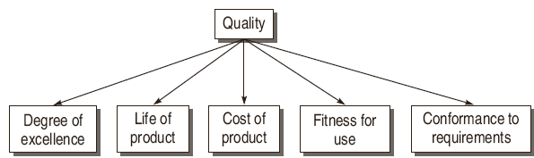
Evolution of Software Testing
Quality as Multidimensional Concept
© Oxford University Press 2011. All rights reserved.

Slide 3
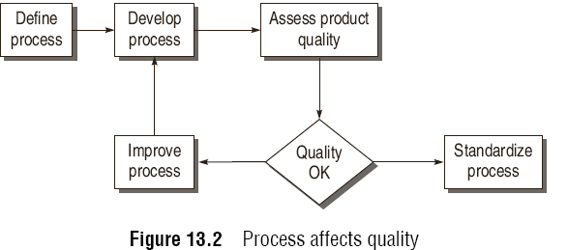
Evolution of Software Testing
Broadening the Concept of Quality
Product Quality: To improve end product
Process Quality
© Oxford University Press 2011. All rights reserved.

Slide 4
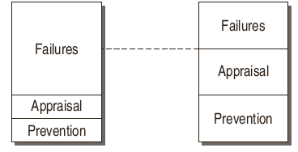
Quality Cost
Prevention costs
Appraisal costs
Failure costs
© Oxford University Press 2011. All rights reserved.

Slide 5
Quality Control and Quality Assurance
Quality Control is basically related to software product such that there is minimum variation, according to the desired specifications. This variation is checked at each step of development. Quality control may include the following activities: Reviews, Testing using manual techniques or with automated tools (V & V).
Quality Assurance is largely related to the process. In addition, quality assurance activities are in management zone. Therefore auditing and reporting of quality based on quantitative measurements are also performed.
© Oxford University Press 2011. All rights reserved.

Slide 6
Quality Management
Quality management is to
plan suitable Quality control and Quality assurance activities,
define procedures and standards which should be used during software development and verifying that these are being followed by everyone
Properly execute and control activities.
© Oxford University Press 2011. All rights reserved.

Slide 7
Quality Factors
Functionality
Correctness
Completeness
Efficiency
Portability
Testability
Usability
Reliability
Reusability
Maintainability
© Oxford University Press 2011. All rights reserved.

Slide 8
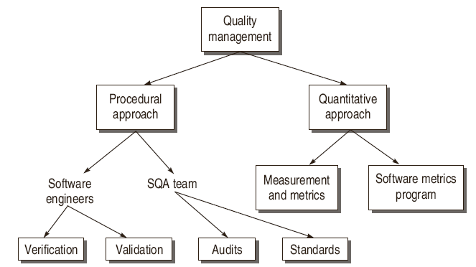
Software Testing Myths
Methods of quality management
© Oxford University Press 2011. All rights reserved.

Slide 9
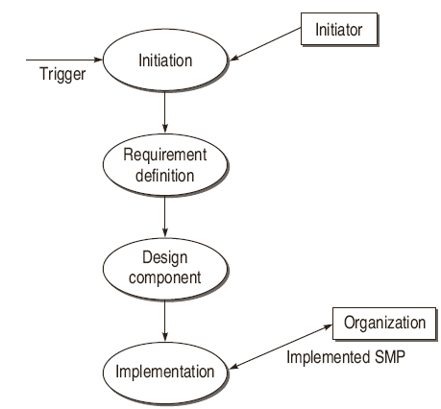
Paul Goodman Model for Software
Metrics Program
© Oxford University Press 2011. All rights reserved.

Slide 10
Software Quality Metrics
Product Quality Metrics
Mean time to failure (MTTF)
MTTF metric is an estimate of the average or mean time until a product’s first failure occurs.
Defect Density Metrics
Defect Density = Number of Defects / Size of Product
Customer problem metrics
problems per user month (PUM) = Total problems reported by the customer for a time period / Total number of licensed months of the software during the period.
© Oxford University Press 2011. All rights reserved.

Slide 11
Software Quality Metrics
In-Process Quality Metrics
Defect Density during testing
Defect Arrival pattern during Testing
Defect Removal Efficiency
DRE = (Defects removed during a development phase / Defects latent in the product) X 100%
© Oxford University Press 2011. All rights reserved.

Slide 12
Software Quality Metrics
Metrics for Software maintenance
Fix backlog and backlog management index
BMI = (Number of problems closed during the month / Number of problem arrivals during the month) x 100 %
Fix response time and fix responsiveness
Percent Delinquent fixes
Percent Delinquent fixes = (Number of fixes that exceeded the response time criteria by severity level / Number of fixes delivered in a specified time) X 100%
Fix Quality
© Oxford University Press 2011. All rights reserved.

Slide 13
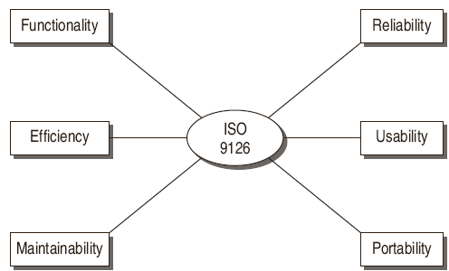
SQA Models
ISO 9126
© Oxford University Press 2011. All rights reserved.

Slide 14

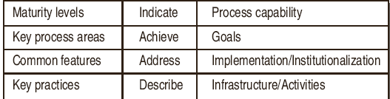
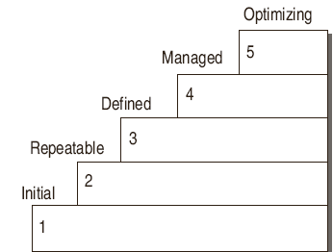
Capability Maturity Model (CMM)
© Oxford University Press 2011. All rights reserved.

Slide 15
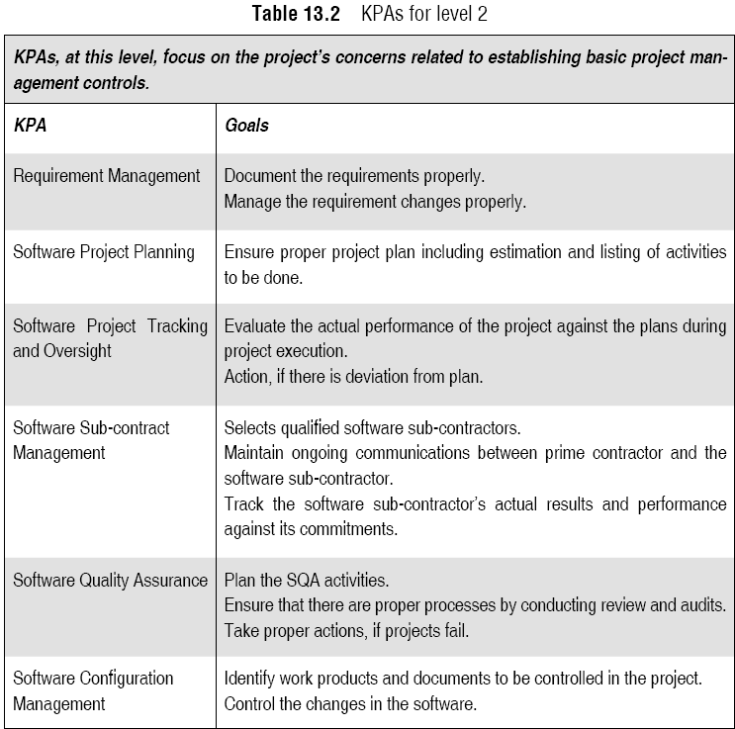
Capability Maturity Model (CMM)
© Oxford University Press 2011. All rights reserved.

Slide 16
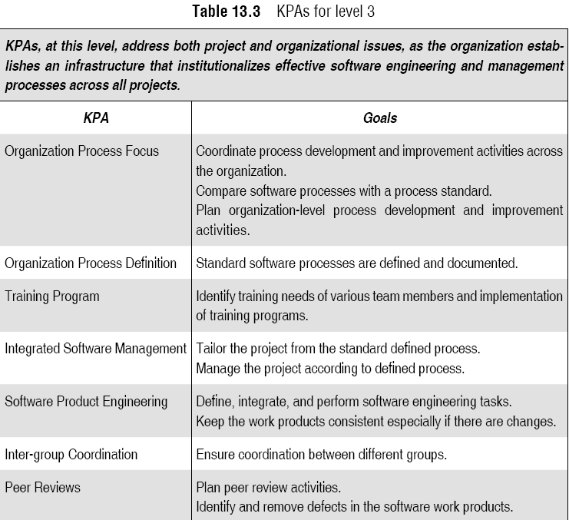
Capability Maturity Model (CMM)
© Oxford University Press 2011. All rights reserved.

Slide 17
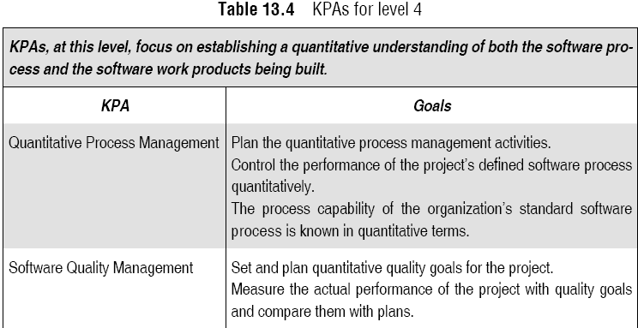
Capability Maturity Model (CMM)
© Oxford University Press 2011. All rights reserved.

Slide 18
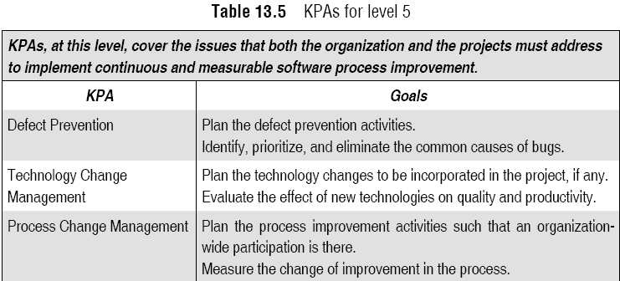
Capability Maturity Model (CMM)
© Oxford University Press 2011. All rights reserved.

Slide 19
Software Total Quality Management (STQM)
TQM is defined as a quality-centered, customer-focused, fact-based, team-driven, senior-management-led process to achieve an organization’s strategic imperative through continuous process improvement.
T = Total = everyone in the organization
Q = Quality = customer satisfaction
M = Management = people and processes
© Oxford University Press 2011. All rights reserved.

Slide 20
Six Sigma
Six sigma is way to achieve strategic business results emphasizing lower costs with less number of defects. Six sigma processes will produce less than 3.4 defects per million opportunities. To achieve this target, it uses a methodology known as DMAIC having the following steps:
  Define opportunities,
  Measure performance,
  Analyze opportunity,
  Improve performance,
  Control performance
© Oxford University Press 2011. All rights reserved.

